Slide 1
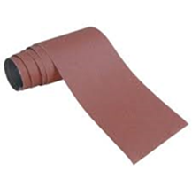

Sandpapers
Purpose -they are used for preparing surfaces for finishing and painting.
Types of sandpapers
1. Commercial grade
e.g
2. Industrial grade
e.g

Slide 2
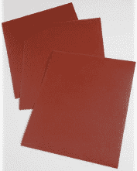

Sizes of sandpapers
1. Coarse size
-Grit 40 -100
- It is used for DIY projects that requires heavy duty sanding work.
2. Medium size
- Grit 120-180
- It is used for DIY projects that requires smooth surfaces.

Slide 3


3. Fine size
-Grit 220 -280
- It is used for DIY projects that requires final sanding before finishing.
4. Very fine size
- Grit 320-upwards
- It is used for removal of scratches.

Slide 4

5. Wet size
- Grit 220 -280
- It is used for DIY projects that requires final sanding before finishing.
Demonstration Video :
-
Feedback : Activity

Slide 5


Kwa Thema Skills School
Subject : Maintenance Marks : 8
Grade : Year 2 Time : 30mins
Date :
Question:1
1. What is the use of a sandpaper?
1.1 _____________________________________________________________
2. Give the names of the sandpapers shown below:
2.1 ___________________
2.2 ___________________

Slide 6
3. Give the names of the following sizes of sandpapers shown below:
4. Where do we use the medium size sandpaper?
4.1 ______________________________________________________.
5. Where do we use coarse size sandpaper?
5.1 ______________________________________________________.
(10)
 | Grit or Size | Name of the sandpaper
1. | ( 220 – 280)
2. | ( 320 – upward)
3. | ( 40 – 120)
4. | ( 220 – 280)
5. | ( 120 – 180)

